Slide 1


Big Data Infrastructure
Session 9: Beyond MapReduce — Dataflow Languages
Jimmy Lin
University of Maryland
Monday, April 6, 2015
This work is licensed under a Creative Commons Attribution-Noncommercial-Share Alike 3.0 United States See http://creativecommons.org/licenses/by-nc-sa/3.0/us/ for details

Slide 2
Today’s Agenda
What’s beyond MapReduce?
SQL on Hadoop
Dataflow languages
Past and present developments

Slide 3
A Major Step Backwards?
MapReduce is a step backward in database access:
Schemas are good
Separation of the schema from the application is good
High-level access languages are good
MapReduce is poor implementation
Brute force and only brute force (no indexes, for example)
MapReduce is not novel
MapReduce is missing features
Bulk loader, indexing, updates, transactions…
MapReduce is incompatible with DMBS tools
✔
✔
?
✔
?
Source: Blog post by DeWitt and Stonebraker

Slide 4
Need for High-Level Languages
Hadoop is great for large-data processing!
But writing Java programs for everything is verbose and slow
Data scientists don’t want to write Java
Solution: develop higher-level data processing languages
Hive: HQL is like SQL
Pig: Pig Latin is a bit like Perl

Slide 5


Hive and Pig
Hive: data warehousing application in Hadoop
Query language is HQL, variant of SQL
Tables stored on HDFS with different encodings
Developed by Facebook, now open source
Pig: large-scale data processing system
Scripts are written in Pig Latin, a dataflow language
Programmer focuses on data transformations
Developed by Yahoo!, now open source
Common idea:
Provide higher-level language to facilitate large-data processing
Higher-level language “compiles down” to Hadoop jobs

Slide 6

Jeff Hammerbacher, Information Platforms and the Rise of the Data Scientist. In, Beautiful Data, O’Reilly, 2009.
“On the first day of logging the Facebook clickstream, more than 400 gigabytes of data was collected. The load, index, and aggregation processes for this data set really taxed the Oracle data warehouse. Even after significant tuning, we were unable to aggregate a day of clickstream data in less than 24 hours.”

Slide 7
Hive: Example
Hive looks similar to an SQL database
Relational join on two tables:
Table of word counts from Shakespeare collection
Table of word counts from the bible
SELECT s.word, s.freq, k.freq FROM shakespeare s
JOIN bible k ON (s.word = k.word) WHERE s.freq >= 1 AND k.freq >= 1 ORDER BY s.freq DESC LIMIT 10;
the 25848 62394
I 23031 8854
and 19671 38985
to 18038 13526
of 16700 34654
a 14170 8057
you 12702 2720
my 11297 4135
in 10797 12445
is 8882 6884
Source: Material drawn from Cloudera training VM

Slide 8
Hive: Behind the Scenes
SELECT s.word, s.freq, k.freq FROM shakespeare s
JOIN bible k ON (s.word = k.word) WHERE s.freq >= 1 AND k.freq >= 1 ORDER BY s.freq DESC LIMIT 10;
(Abstract Syntax Tree)
(TOK_QUERY (TOK_FROM (TOK_JOIN (TOK_TABREF shakespeare s) (TOK_TABREF bible k) (= (. (TOK_TABLE_OR_COL s) word) (. (TOK_TABLE_OR_COL k) word)))) (TOK_INSERT (TOK_DESTINATION (TOK_DIR TOK_TMP_FILE)) (TOK_SELECT (TOK_SELEXPR (. (TOK_TABLE_OR_COL s) word)) (TOK_SELEXPR (. (TOK_TABLE_OR_COL s) freq)) (TOK_SELEXPR (. (TOK_TABLE_OR_COL k) freq))) (TOK_WHERE (AND (>= (. (TOK_TABLE_OR_COL s) freq) 1) (>= (. (TOK_TABLE_OR_COL k) freq) 1))) (TOK_ORDERBY (TOK_TABSORTCOLNAMEDESC (. (TOK_TABLE_OR_COL s) freq))) (TOK_LIMIT 10)))
(one or more of MapReduce jobs)

Slide 9
Hive: Behind the Scenes
STAGE DEPENDENCIES:
Stage-1 is a root stage
Stage-2 depends on stages: Stage-1
Stage-0 is a root stage
STAGE PLANS:
Stage: Stage-1
Map Reduce
Alias -> Map Operator Tree:
s
TableScan
alias: s
Filter Operator
predicate:
expr: (freq >= 1)
type: boolean
Reduce Output Operator
key expressions:
expr: word
type: string
sort order: +
Map-reduce partition columns:
expr: word
type: string
tag: 0
value expressions:
expr: freq
type: int
expr: word
type: string
k
TableScan
alias: k
Filter Operator
predicate:
expr: (freq >= 1)
type: boolean
Reduce Output Operator
key expressions:
expr: word
type: string
sort order: +
Map-reduce partition columns:
expr: word
type: string
tag: 1
value expressions:
expr: freq
type: int
Stage: Stage-2
Map Reduce
Alias -> Map Operator Tree:
hdfs://localhost:8022/tmp/hive-training/364214370/10002
Reduce Output Operator
key expressions:
expr: _col1
type: int
sort order: -
tag: -1
value expressions:
expr: _col0
type: string
expr: _col1
type: int
expr: _col2
type: int
Reduce Operator Tree:
Extract
Limit
File Output Operator
compressed: false
GlobalTableId: 0
table:
input format: org.apache.hadoop.mapred.TextInputFormat
output format: org.apache.hadoop.hive.ql.io.HiveIgnoreKeyTextOutputFormat
Stage: Stage-0
Fetch Operator
limit: 10
Reduce Operator Tree:
Join Operator
condition map:
Inner Join 0 to 1
condition expressions:
0 {VALUE._col0} {VALUE._col1}
1 {VALUE._col0}
outputColumnNames: _col0, _col1, _col2
Filter Operator
predicate:
expr: ((_col0 >= 1) and (_col2 >= 1))
type: boolean
Select Operator
expressions:
expr: _col1
type: string
expr: _col0
type: int
expr: _col2
type: int
outputColumnNames: _col0, _col1, _col2
File Output Operator
compressed: false
GlobalTableId: 0
table:
input format: org.apache.hadoop.mapred.SequenceFileInputFormat
output format: org.apache.hadoop.hive.ql.io.HiveSequenceFileOutputFormat

Slide 10
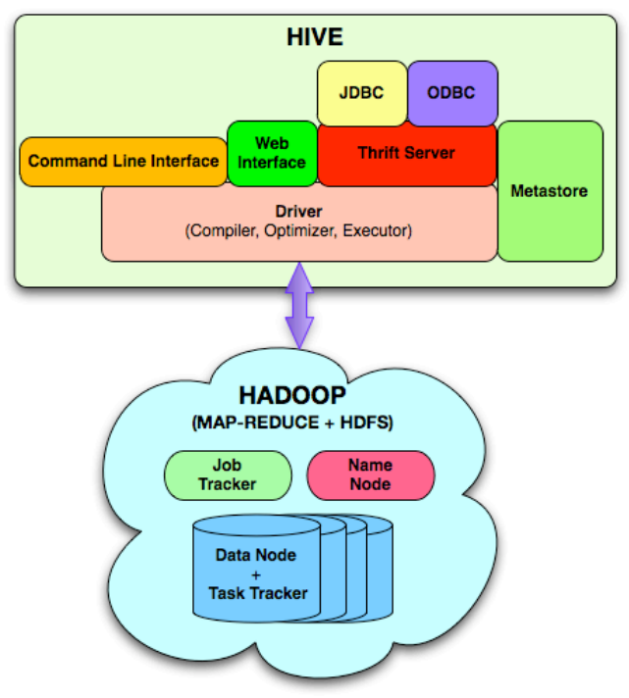
Hive Architecture

Slide 11
Hive Implementation
Metastore holds metadata
Databases, tables
Schemas (field names, field types, etc.)
Permission information (roles and users)
Hive data stored in HDFS
Tables in directories
Partitions of tables in sub-directories
Actual data in files

Slide 12
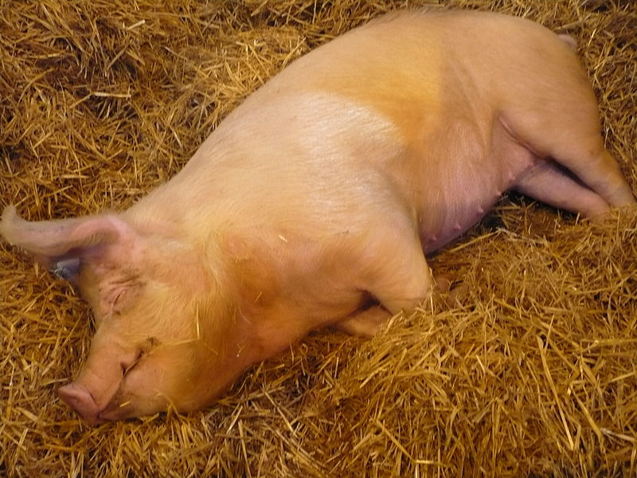
Pig!
Source: Wikipedia (Pig)

Slide 13
Pig: Example
Task: Find the top 10 most visited pages in each category
Visits
Url Info
User | Url | Time
Amy | cnn.com | 8:00
Amy | bbc.com | 10:00
Amy | flickr.com | 10:05
Fred | cnn.com | 12:00
Url | Category | PageRank
cnn.com | News | 0.9
bbc.com | News | 0.8
flickr.com | Photos | 0.7
espn.com | Sports | 0.9
Pig Slides adapted from Olston et al. (SIGMOD 2008)

Slide 14
Pig Script
visits = load ‘/data/visits’ as (user, url, time);
gVisits = group visits by url;
visitCounts = foreach gVisits generate url, count(visits);
urlInfo = load ‘/data/urlInfo’ as (url, category, pRank);
visitCounts = join visitCounts by url, urlInfo by url;
gCategories = group visitCounts by category;
topUrls = foreach gCategories generate top(visitCounts,10);
store topUrls into ‘/data/topUrls’;
Pig Slides adapted from Olston et al. (SIGMOD 2008)

Slide 15
Pig Query Plan
Load Visits
Group by url
Foreach url
generate count
Load Url Info
Join on url
Group by category
Foreach category
generate top10(urls)
Pig Slides adapted from Olston et al. (SIGMOD 2008)

Slide 16
Pig Script in Hadoop
Map₁
Load Visits
Group by url
Reduce₁
Map₂
Foreach url
generate count
Load Url Info
Join on url
Reduce₂
Map₃
Group by category
Reduce₃
Foreach category
generate top10(urls)
Pig Slides adapted from Olston et al. (SIGMOD 2008)

Slide 17
Pig: Basics
Sequence of statements manipulating relations (aliases)
Data model
atoms
tuples
bags
maps
json

Slide 18
Pig: Common Operations
LOAD: load data
FOREACH … GENERATE: per tuple processing
FILTER: discard unwanted tuples
GROUP/COGROUP: group tuples
JOIN: relational join

Slide 19
Pig: GROUPing
A = LOAD 'myfile.txt’ AS (f1: int, f2: int, f3: int);
(1, 2, 3)
(4, 2, 1)
(8, 3, 4)
(4, 3, 3)
(7, 2, 5)
(8, 4, 3)
X = GROUP A BY f1;
(1, {(1, 2, 3)})
(4, {(4, 2, 1), (4, 3, 3)})
(7, {(7, 2, 5)})
(8, {(8, 3, 4), (8, 4, 3)})

Slide 20
Pig: COGROUPing
A:
(1, 2, 3)
(4, 2, 1)
(8, 3, 4)
(4, 3, 3)
(7, 2, 5)
(8, 4, 3)
B:
(2, 4)
(8, 9)
(1, 3)
(2, 7)
(2, 9)
(4, 6)
(4, 9)
X = COGROUP A BY f1, B BY $0;
(1, {(1, 2, 3)}, {(1, 3)})
(2, {}, {(2, 4), (2, 7), (2, 9)})
(4, {(4, 2, 1), (4, 3, 3)}, {(4, 6),(4, 9)})
(7, {(7, 2, 5)}, {})
(8, {(8, 3, 4), (8, 4, 3)}, {(8, 9)})

Slide 21
Pig UDFs
User-defined functions:
Java
Python
JavaScript
Ruby
UDFs make Pig arbitrarily extensible
Express “core” computations in UDFs
Take advantage of Pig as glue code for scale-out plumbing

Slide 22
PageRank in Pig
previous_pagerank = LOAD ‘$docs_in’ USING PigStorage()
AS (url: chararray, pagerank: float,
links:{link: (url: chararray)});
outbound_pagerank = FOREACH previous_pagerank
GENERATE pagerank / COUNT(links) AS pagerank,
FLATTEN(links) AS to_url;
new_pagerank =
FOREACH ( COGROUP outbound_pagerank
BY to_url, previous_pagerank BY url INNER )
GENERATE group AS url,
(1 – $d) + $d * SUM(outbound_pagerank.pagerank) AS pagerank,
FLATTEN(previous_pagerank.links) AS links;
STORE new_pagerank INTO ‘$docs_out’ USING PigStorage();
From: http://techblug.wordpress.com/2011/07/29/pagerank-implementation-in-pig/

Slide 23
Oh, the iterative part too…
#!/usr/bin/python
from org.apache.pig.scripting import *
P = Pig.compile(""" Pig part goes here """)
params = { ‘d’: ‘0.5’, ‘docs_in’: ‘data/pagerank_data_simple’ }
for i in range(10):
out = "out/pagerank_data_" + str(i + 1)
params["docs_out"] = out
Pig.fs("rmr " + out)
stats = P.bind(params).runSingle()
if not stats.isSuccessful():
raise ‘failed’
params["docs_in"] = out
From: http://techblug.wordpress.com/2011/07/29/pagerank-implementation-in-pig/

Slide 24
What’s next?

Slide 25

Imapala
Open source analytical database for Hadoop
Tight integration with HDFS and Parquet format
Released October 2012

Slide 26
Impala Architecture
Impala daemon (impalad)
Handles client requests
Handles internal query execution requests
State store daemon (statestored)
Provides name service and metadata distribution

Slide 27
Impala Query Execution
Request arrives
Planner turns request into collections of plan fragments
Coordinator initiates execution on remote impala daemons
Intermediate results are streamed between executors
Query results are streamed back to client

Slide 28
SQL App
Hive Metastore
HDFS NN
Statestore
ODBC
SQL request
Query Planner
Query Planner
Query Planner
Query Coordinator
Query Coordinator
Query Coordinator
Query Executor
Query Executor
Query Executor
HDFS DN
HBase
HDFS DN
HBase
HDFS DN
HBase

Slide 29
SQL App
Hive Metastore
HDFS NN
Statestore
ODBC
Query Planner
Query Planner
Query Planner
Query Coordinator
Query Coordinator
Query Coordinator
Query Executor
Query Executor
Query Executor
HDFS DN
HBase
HDFS DN
HBase
HDFS DN
HBase

Slide 30
SQL App
Hive Metastore
HDFS NN
Statestore
ODBC
Query results
Query Planner
Query Planner
Query Planner
Query Coordinator
Query Coordinator
Query Coordinator
Query Executor
Query Executor
Query Executor
HDFS DN
HBase
HDFS DN
HBase
HDFS DN
HBase

Slide 31
Impala Execution Engine
Written in C++
Runtime code generation for “big loops” (via LLVM)

Slide 32

The datacenter is the computer!
What’s the instruction set?
Source: Google

Slide 33
Answer?
k₁
v₁
k₂
v₂
k₃
v₃
k₄
v₄
k₅
v₅
k₆
v₆
map
map
map
map
a
1
b
2
c
3
c
6
a
5
c
2
b
7
c
8
Shuffle and Sort: aggregate values by keys
a
1
5
b
2
7
c
2
3
6
8
reduce
reduce
reduce
r₁
s₁
r₂
s₂
r₃
s₃

Slide 34
Answer?
Map₁
Load Visits
Group by url
Reduce₁
Map₂
Foreach url
generate count
Load Url Info
Join on url
Reduce₂
Map₃
Group by category
Reduce₃
Foreach category
generate top10(urls)
Pig Slides adapted from Olston et al. (SIGMOD 2008)

Slide 35
Generically, what is this?
Collections of tuples
Load Visits
Group by url
Foreach url
generate count
Load Url Info
Join on url
Group by category
Transformations on those collections
Foreach category
generate top10(urls)
Pig Slides adapted from Olston et al. (SIGMOD 2008)

Slide 36
Dataflows
Comprised of:
Collections of records
Transformations on those collections
Two important questions:
What are the logical operators?
What are the physical operators?

Slide 37
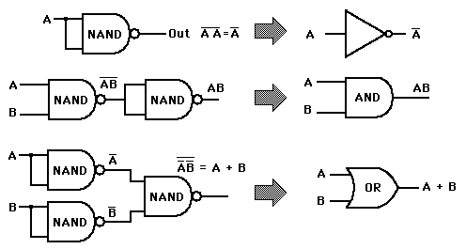
Analogy: NAND Gates are universal

Slide 38
Dryad: Graph Operators
Source: Isard et al. (2007) Dryad: Distributed Data-Parallel Programs from Sequential Building Blocks. EuroSys.

Slide 39
Dryad: Architecture
The Dryad system organization. The job manager (JM) consults the name server (NS) to discover the list of available computers. It maintains the job graph and schedules running vertices (V) as computers become available using the daemon (D) as a proxy. Vertices exchange data through files, TCP pipes, or shared-memory channels. The shaded bar indicates the vertices in the job that are currently running.
Source: Isard et al. (2007) Dryad: Distributed Data-Parallel Programs from Sequential Building Blocks. EuroSys.

Slide 40
Dryad: Cool Tricks
Channel: abstraction for vertex-to-vertex communication
File
TCP pipe
Shared memory
Runtime graph refinement
Size of input is not known until runtime
Automatically rewrite graph based on invariant properties
Source: Isard et al. (2007) Dryad: Distributed Data-Parallel Programs from Sequential Building Blocks. EuroSys.

Slide 41
Dryad: Sample Program
Source: Isard et al. (2007) Dryad: Distributed Data-Parallel Programs from Sequential Building Blocks. EuroSys.

Slide 42
DryadLINQ
LINQ = Language INtegrated Query
.NET constructs for combining imperative and declarative programming
Developers write in DryadLINQ
Program compiled into computations that run on Dryad
Sound familiar?
Source: Yu et al. (2008) DryadLINQ: A System for General-Purpose Distributed Data-Parallel Computing Using a High-Level Language. OSDI.

Slide 43
DryadLINQ: Word Count
PartitionedTable<LineRecord> inputTable =
PartitionedTable.Get<LineRecord>(uri);
IQueryable<string> words = inputTable.SelectMany(x => x.line.Split(' '));
IQueryable<IGrouping<string, string>> groups = words.GroupBy(x => x);
IQueryable<Pair> counts = groups.Select(x => new Pair(x.Key, x.Count()));
IQueryable<Pair> ordered = counts.OrderByDescending(x => x.Count);
IQueryable<Pair> top = ordered.Take(k);
Compare:
a = load ’file.txt' as (text: chararray);
b = foreach a generate flatten(TOKENIZE(text)) as term;
c = group b by term;
d = foreach c generate group as term, COUNT(b) as count;
store d into 'cnt';
Compare and contrast…

Slide 44
What happened to Dryad?
The Dryad system organization. The job manager (JM) consults the name server (NS) to discover the list of available computers. It maintains the job graph and schedules running vertices (V) as computers become available using the daemon (D) as a proxy. Vertices exchange data through files, TCP pipes, or shared-memory channels. The shaded bar indicates the vertices in the job that are currently running.
Source: Isard et al. (2007) Dryad: Distributed Data-Parallel Programs from Sequential Building Blocks. EuroSys.

Slide 45
Spark
One popular answer to “What’s beyond MapReduce?”
Open-source engine for large-scale batch processing
Supports generalized dataflows
Written in Scala, with bindings in Java and Python
Brief history:
Developed at UC Berkeley AMPLab in 2009
Open-sourced in 2010
Became top-level Apache project in February 2014
Commercial support provided by DataBricks

Slide 46
Resilient Distributed Datasets (RDDs)
RDD: Spark “primitive” representing a collection of records
Immutable
Partitioned (the D in RDD)
Transformations operate on an RDD to create another RDD
Coarse-grained manipulations only
RDDs keep track of lineage
Persistence
RDDs can be materialized in memory or on disk
OOM or machine failures: What happens?
Fault tolerance (the R in RDD):
RDDs can always be recomputed from stable storage (disk)

Slide 47
Operations on RDDs
Transformations (lazy):
map
flatMap
filter
union/intersection
join
reduceByKey
groupByKey
…
Actions (actually trigger computations)
collect
saveAsTextFile/saveAsSequenceFile
…

Slide 48
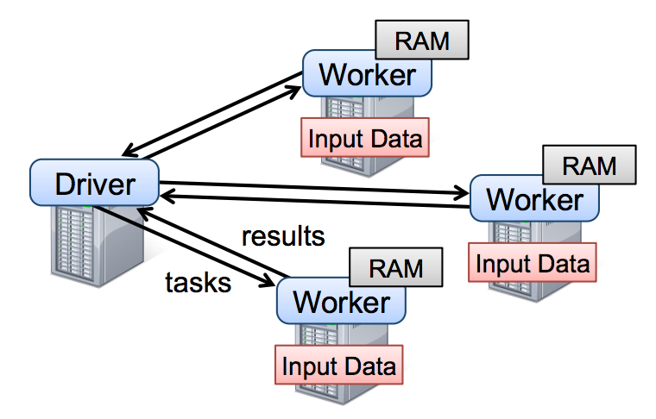
Spark Architecture

Slide 49
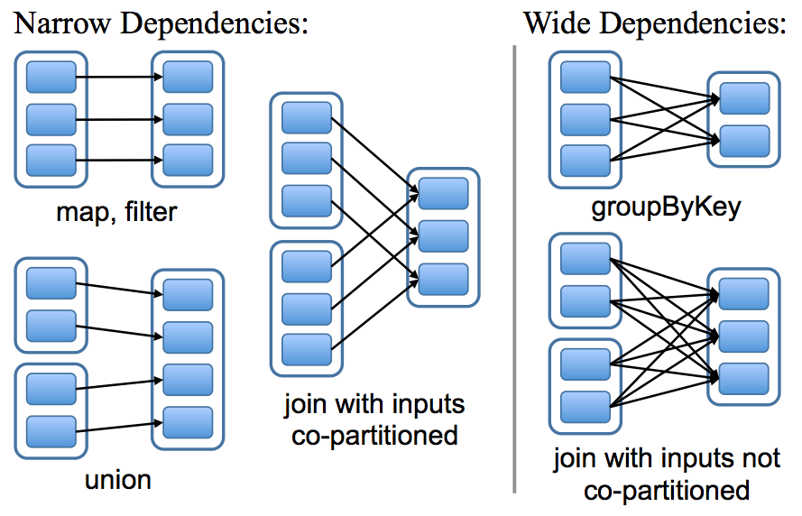
Spark Physical Operators

Slide 50
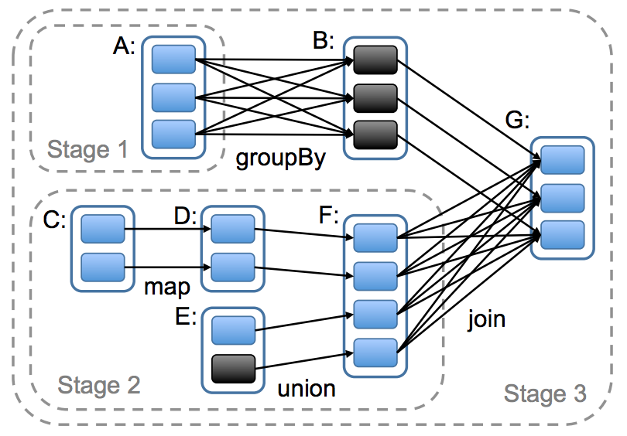
Spark Execution Plan

Slide 51
Today’s Agenda
What’s beyond MapReduce?
SQL on Hadoop
Dataflow languages
Past and present developments

Slide 52

Questions?
Source: Wikipedia (Japanese rock garden)

